Slide 1
LEGISLATIVE
118TH CONGRESS

Slide 2
Legislative Seminar
May 20th – 24th, 2023
Washington, D.C.

Slide 3
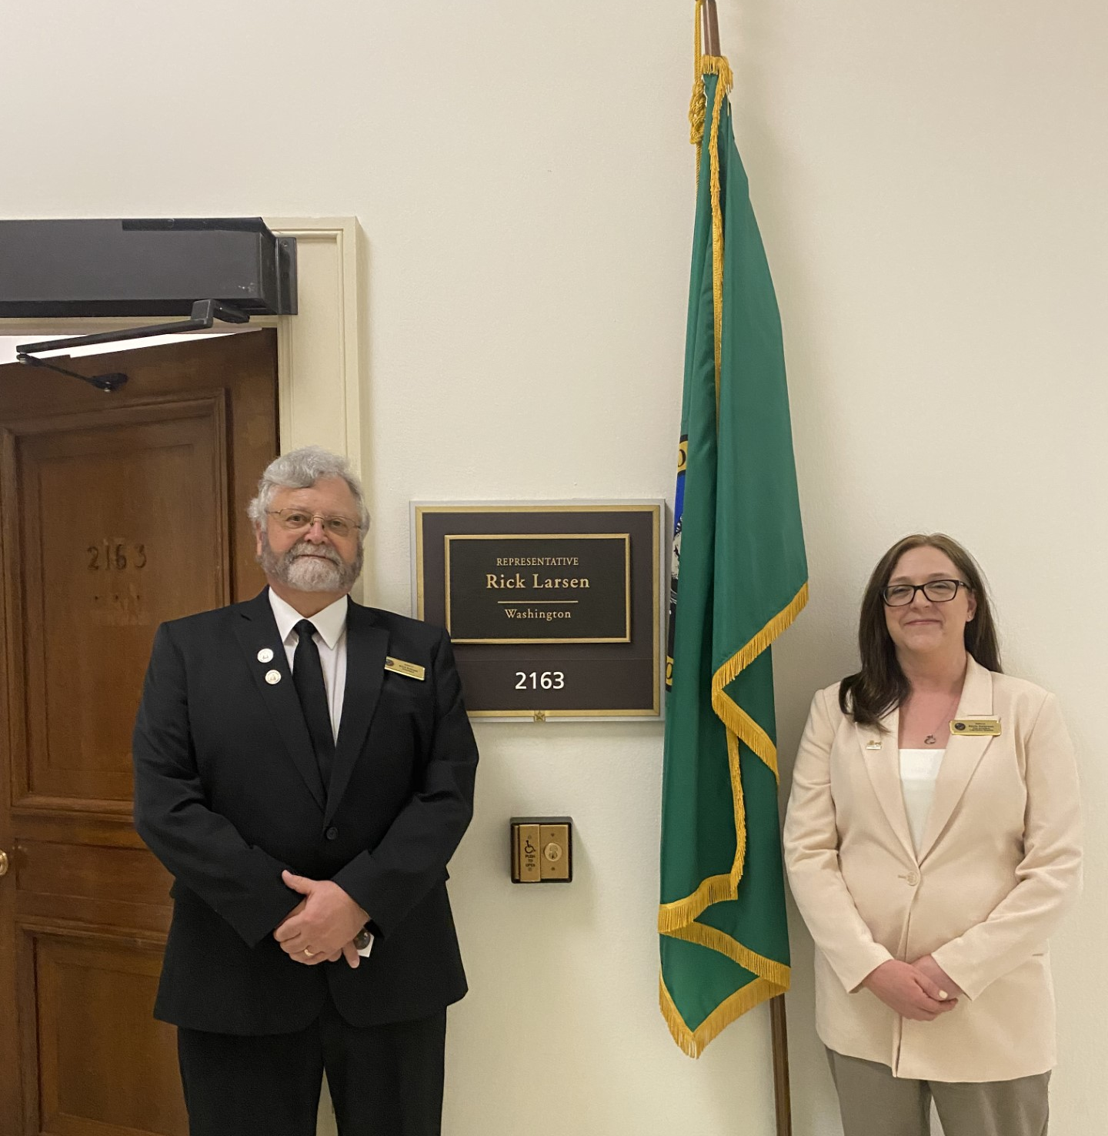
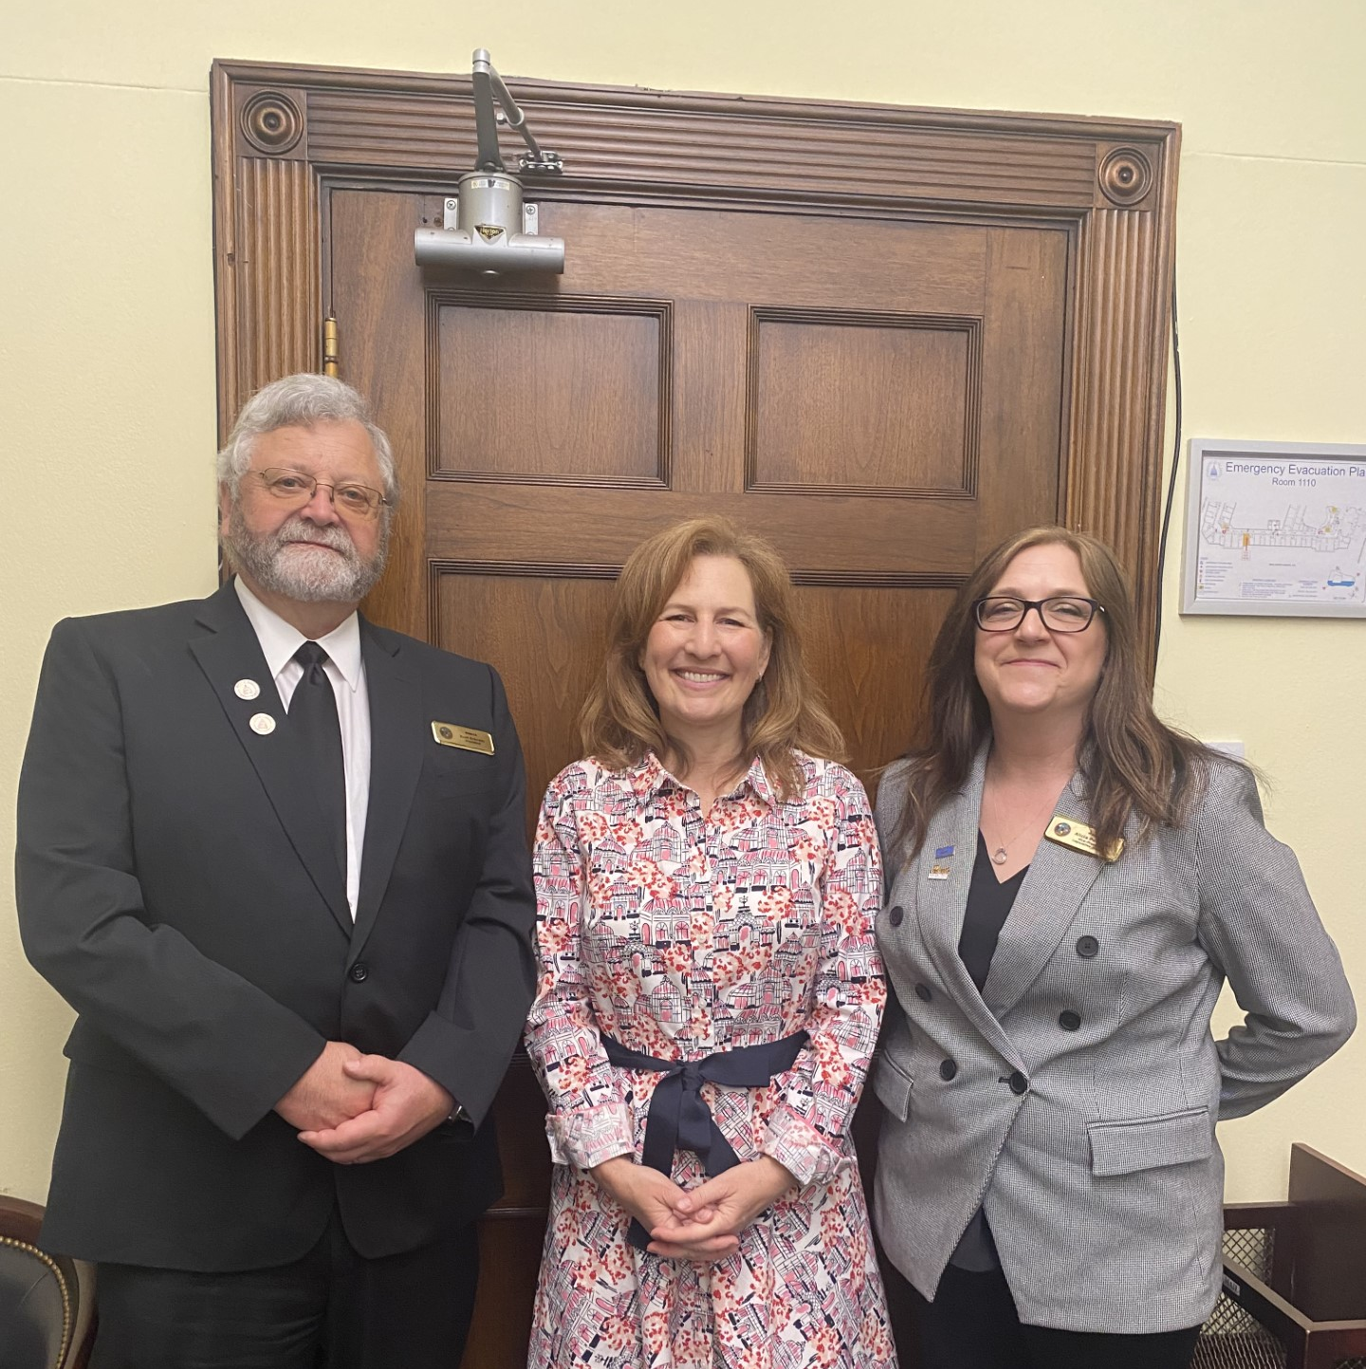
Capitol Hill Visits

Slide 4
SOCIAL SECURITY FAIRNESS ACT H.R. 82/S. 597
Bipartisan Bill introduced by Graves (R-LA) Spanberger (D-VA)
Repeals WEP/GPO (Windfall Elimination Provision/Government Pension Offset)
Eliminates GPO which reduces Social Security benefits for spouses, widows, and widowers who also receive government pension
Eliminates WEP which reduces Social Security benefits for individuals who also receive a pension/disability from an employer that did not withhold Social Security
276 Cosponsors in the House & 44 Cosponsors in the Senate

Slide 5
H.R. 82/S. 597
WASHINGTON COSPONSORS
NOT YET A COSPONSOR
Rep. Newhouse (R-WA-4)
Rep. Kilmer (D-WA-6)
Rep. Larsen (D-WA-2)
Rep. Schrier (D-WA-8)
Rep. DelBene (D-WA-1)
Rep. Strickland (D-WA-10)
Rep. Jayapal (D-WA-7)
Senator Murray (D)
Rep. Gluesenkamp Perez (D-WA-3)
Rep. McMorris Rodgers (R-WA-5)
Rep Smith (D-WA-9)
Senator Cantwell (D)

Slide 6
USPS Shipping Equity Act H.R. 3721
Bipartisan Bill introduced by Newhouse (R-WA) Wexton (D-VA)
Allows Alcoholic beverages to be considered mailable
Revenue generator - $180 Million
Allows licensed producers and retailers to ship directly to consumers over the age of 21, in compliance with state and local laws at the delivery location
USPS already has Adult Signature service
Fairness issue (UPS & FedEx deliver already)
Introduced on May 25, 2023
10 Cosponsors

Slide 7
Federal Retirement Fairness Act
117th Congress: Bipartisan Bill introduced by Kilmer (D-WA) and Cole (R-OK)
Known as the “Buy-Back bill”
Allows the opportunity “buy back” time as a non-career employee and be credited with all years of service upon retirement
Until 1989, RCAs were able to make “catch up” retirement contributions to allow for an on-time retirement
RCA retention rate is extremely low which results in the Postal Service spending millions of dollars for training/hiring
Retention of RCAs would benefit the USPS by reducing overtime payments attributed to the lack of RCAs
Creates an incentive for RCAs to continue their career with the USPS

Slide 8
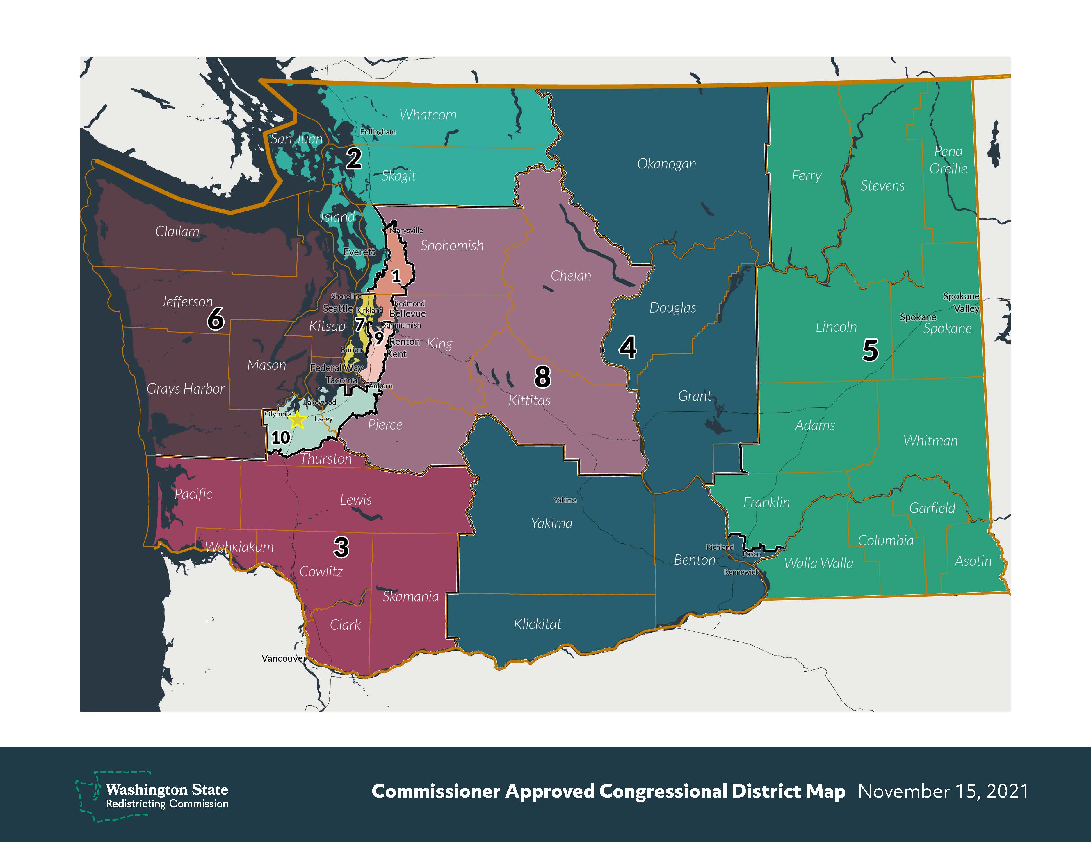
Congressional District Map

Slide 9
2024 Legislative Seminar
April 27 – May 1

